Slide 1
Analysis-Synthesis-Modeling of Inconel 718
An Nguyen

Slide 2
Overview
A workflow incorporating a series of DREAM.3D, Python, Fortran, MATLAB, and Paraview tools to perform analysis, synthesize statistically equivalent microstructures (SE, and model simulated load on material’s Electron Back-Scattered Diffraction (EBSD).
Included a detailed Read-Me regarding how to operate the workflow.

Slide 3
DREAM3D Pipeline 1 – Statistical Analysis
Input:
EBSD file (.ctf, .h5ebsd, and .ang)
Output:
Stats Generator ODF Angle File (.txt) as input for Pipeline 2
Pole Figures for Original EBSD (.pdf)
Feature Data for Original EBSD (.csv) as input for Matlab LognormFit.m
DREAM.3D Data files (.dream3d and .xdmf) as input to Paraview for visualization of grain microstructure.

Slide 4
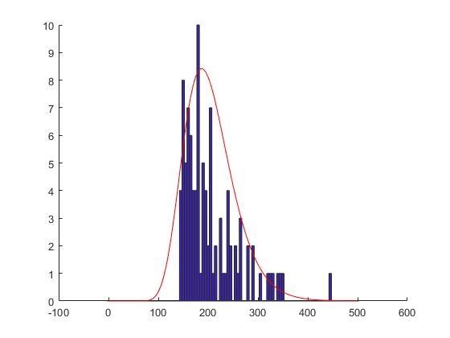
MATLAB Fitting Log-Normal statistic plot on microstructure’s Equivalent Diameter Histogram
Input:
“Equivalent Diameter” (ED) column from Feature Data of Original EBSD.
Output:
Log-Normal fit of ED Histogram
Mu and Sigma values for Pipeline 2

Slide 5
DREAM3D Pipeline 2 – Microstructure Synthesis
Input:
Stats Generator ODF Angle File (.txt)
Mu and Sigma
Ellipsoidal Ratio B/A and C/A (minor/major length on 2 perpendicular planes)
Output
Synthetic Statistically Equivalent (SSE) Microstructures.
Pole Figure for Synthetic EBSD (.pdf)
Feature Data for Synthetic EBSD (.csv)
DREAM.3D Data files (.dream3d and .xdmf) as input to Paraview for visualization of grain microstructure.

Slide 6
DREAM3D Pipeline 3: Abaqus / EVPFFT Input Files
Input:
DREAM3D file of the Original EBSD (2D) OR
DREAM3D file of the Synthetic EBSD (3D)
Output:
Abaqus Hexahedron
Abaqus FEA Input file
Abaqus Surface Mesh
OR
EVPFFT Los Alamos FFT Input file

Slide 7
EVPFFT
Input:
EVPFFT Los Alamos FFT Input File
Output:
Stress and Strain history
Error/ Convergence history
Orientation field
Strain Tensor field
Stress Tensor field
Stress gradient
Orientation Gradient
VTK files for viewing via Paraview

Slide 8
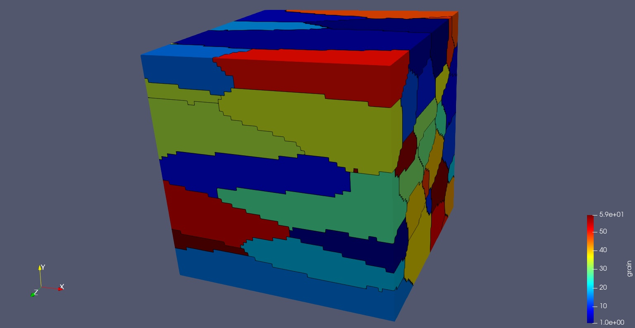
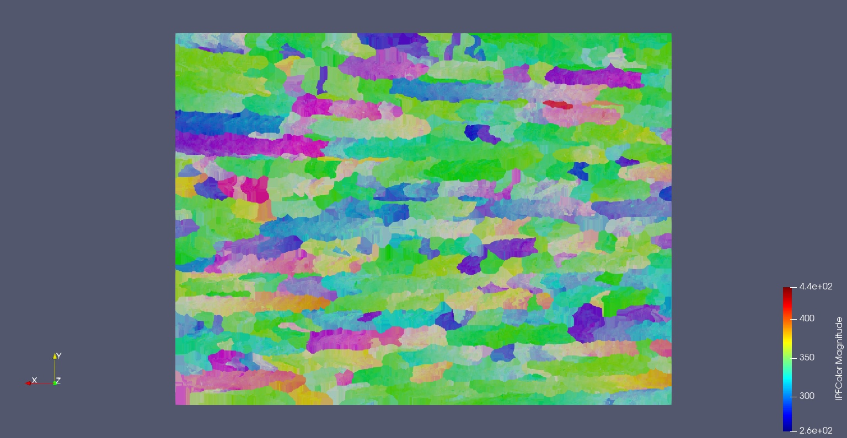
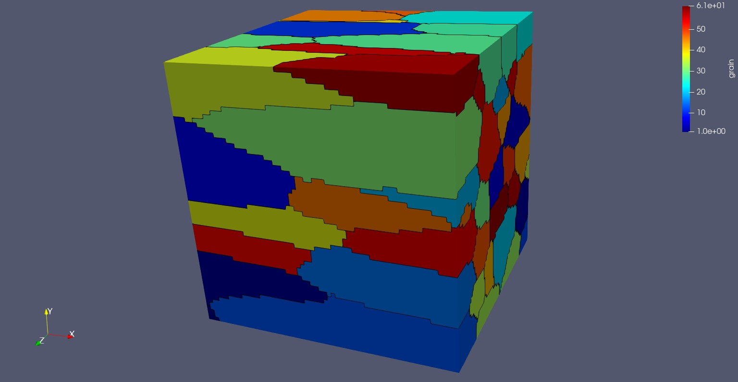
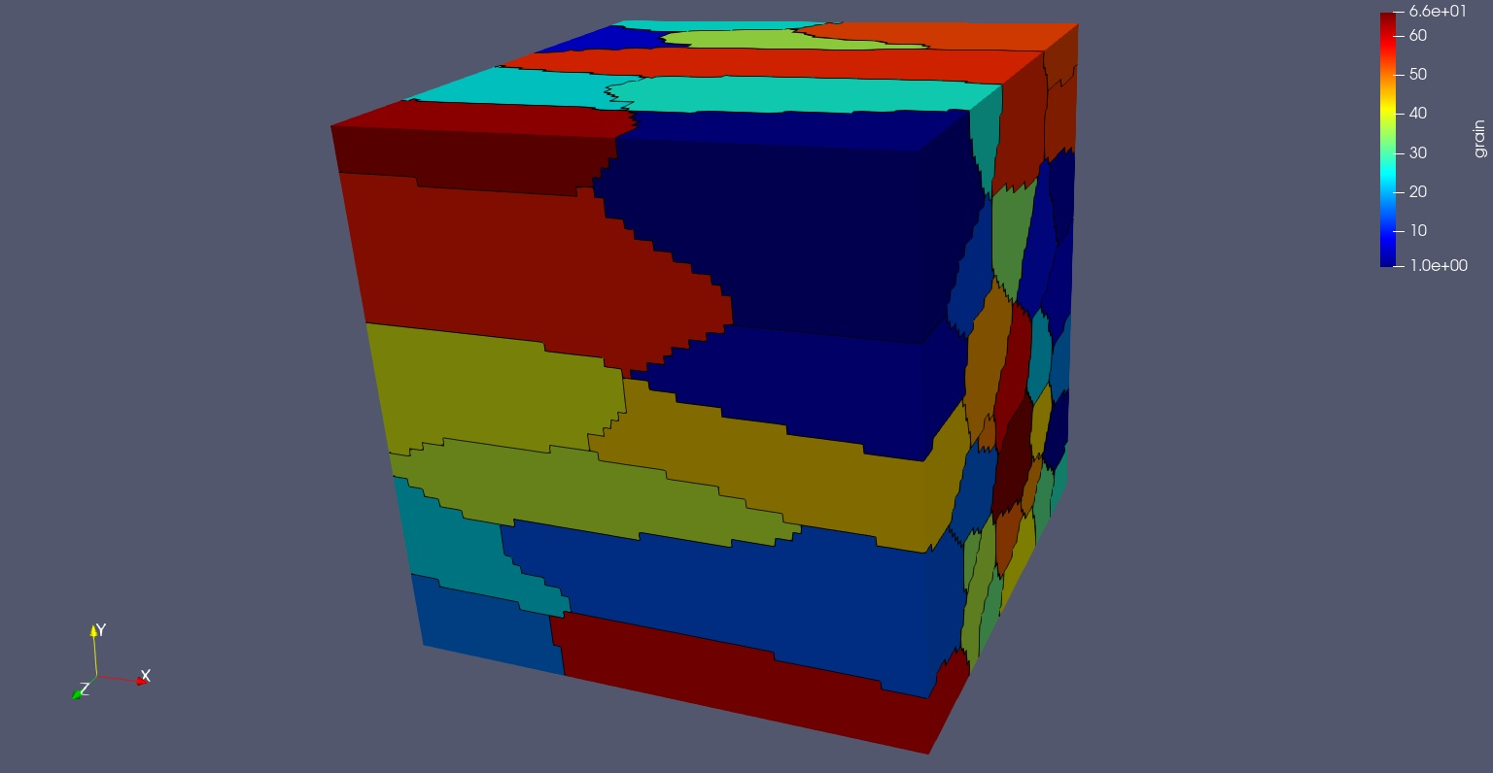
Example: Inconel 718 [Grains]
SSE 1
Original
SSE 2
SSE 3

Slide 9
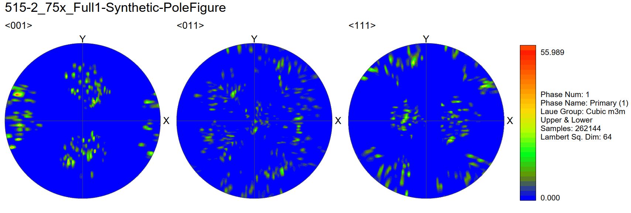
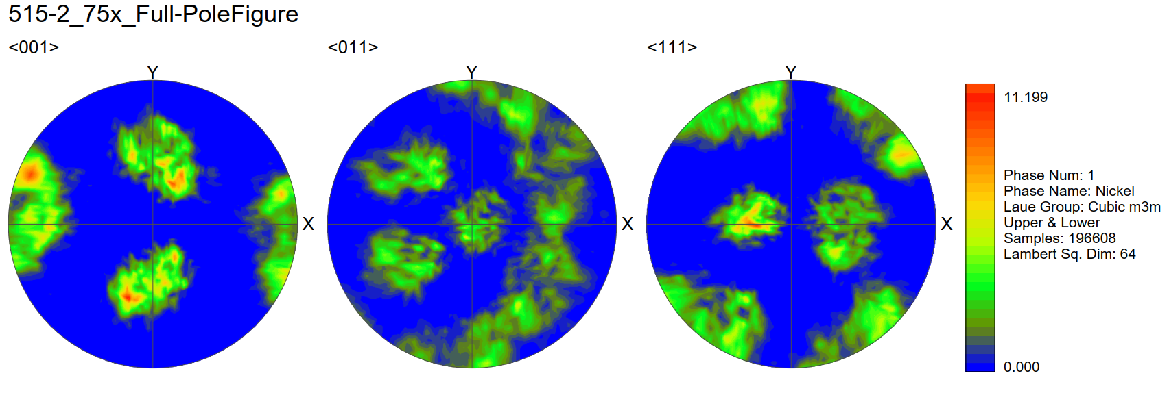
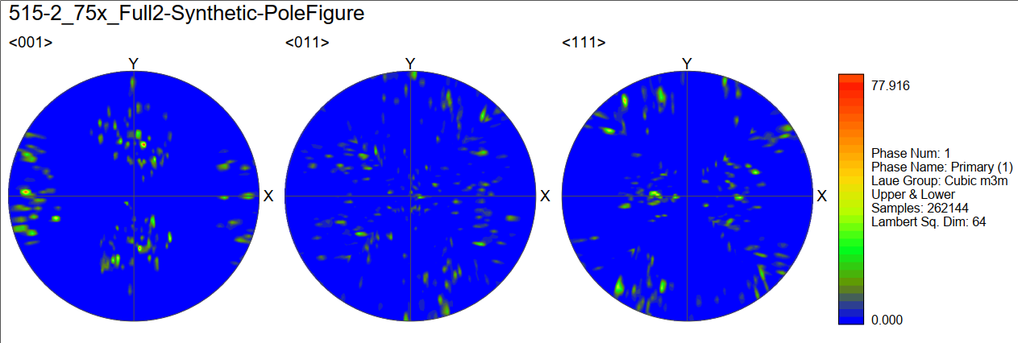

Example: Inconel 718 [Pole Figures]

Slide 10
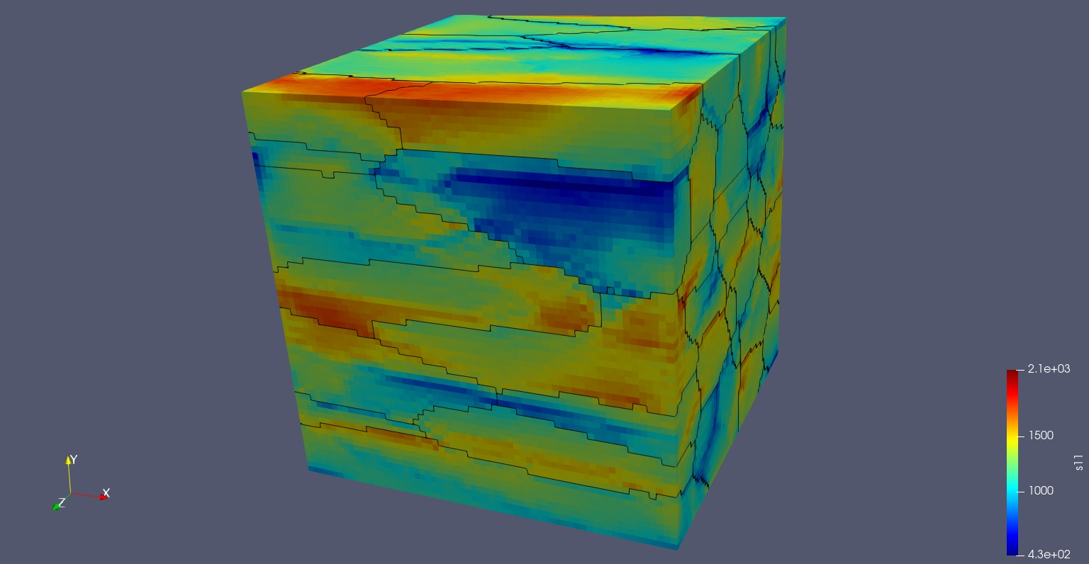
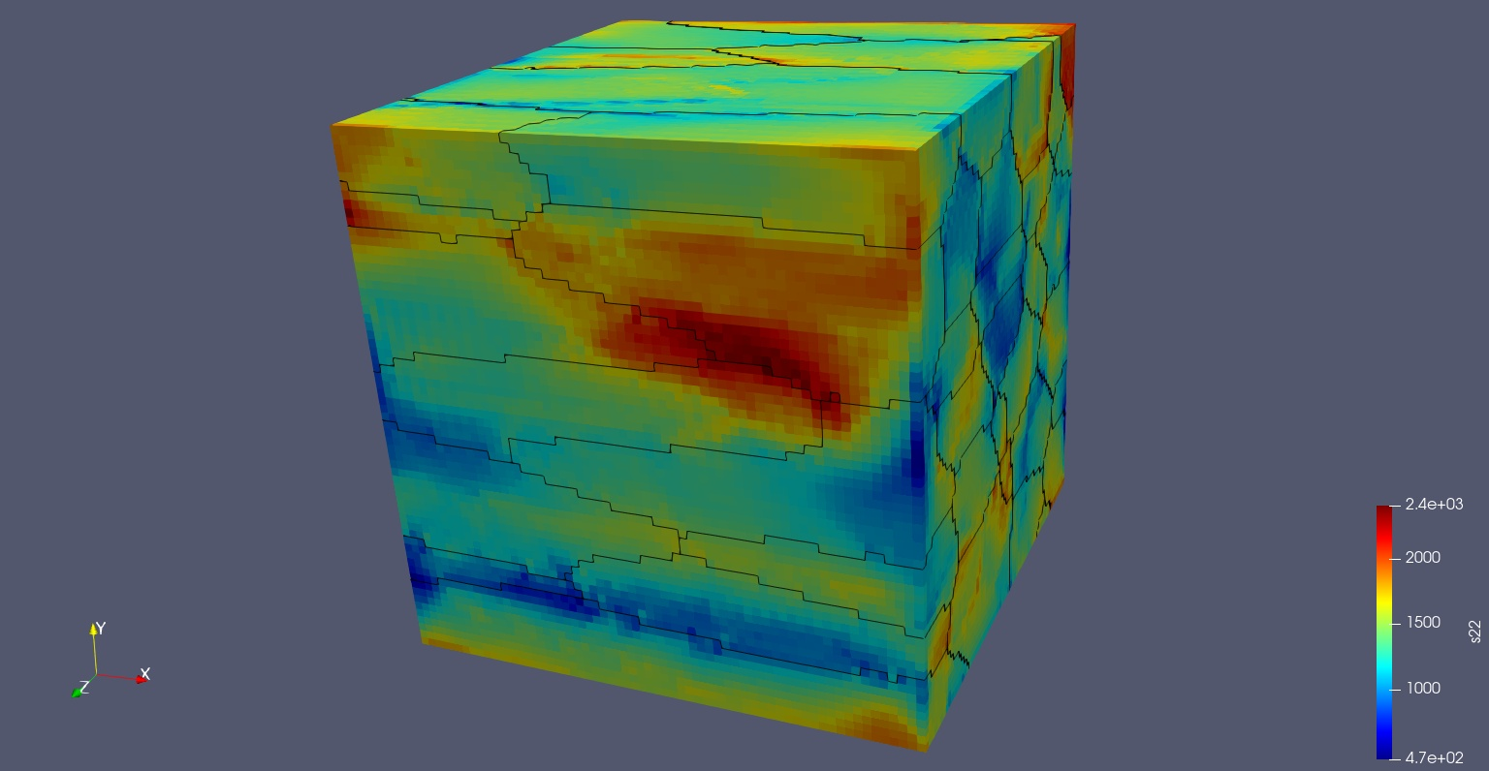
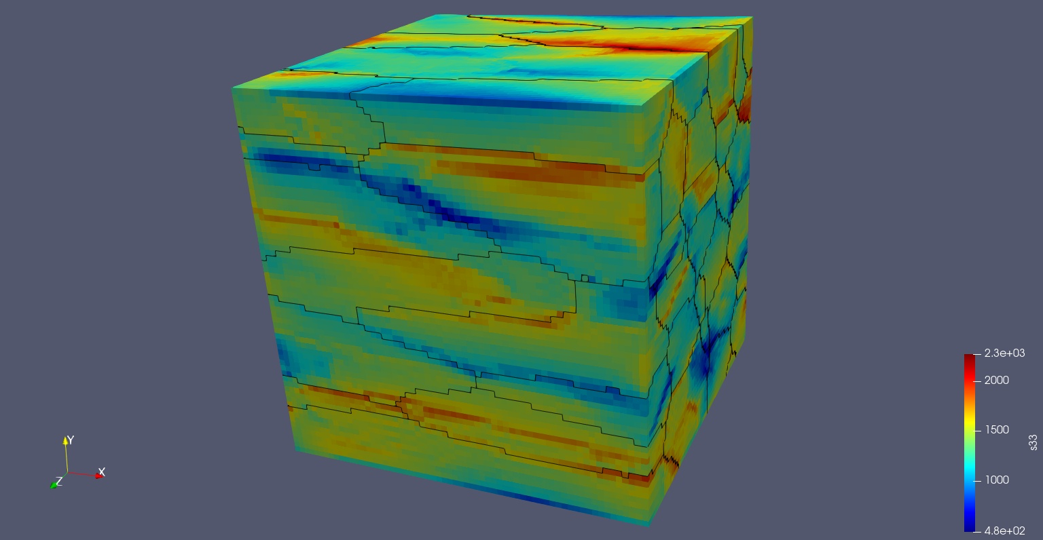
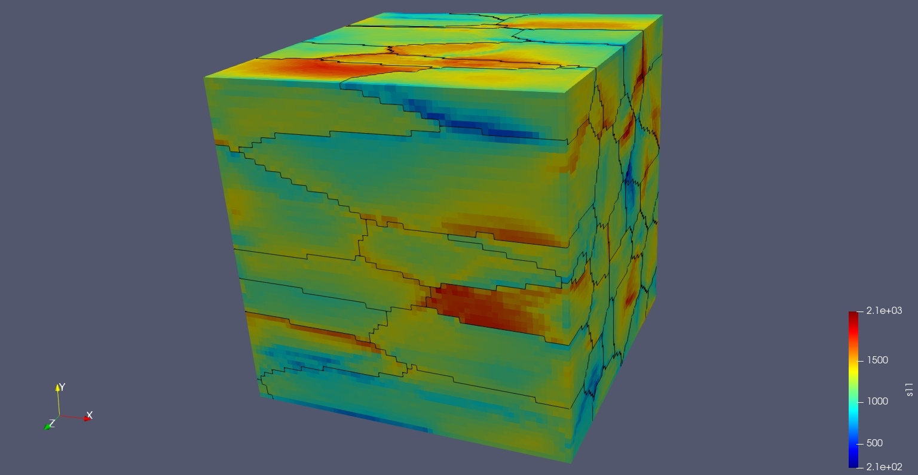
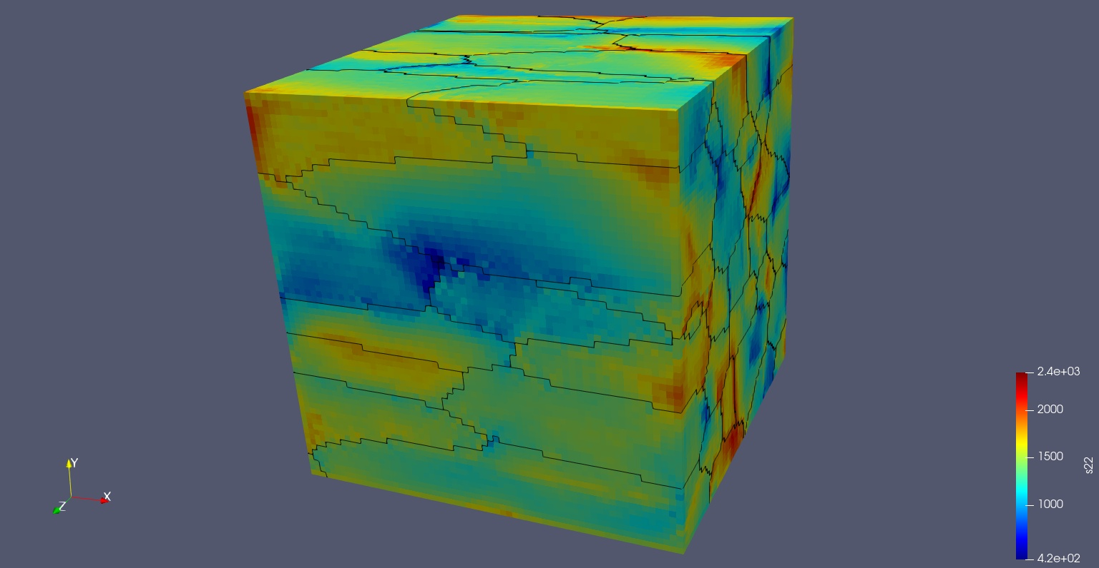
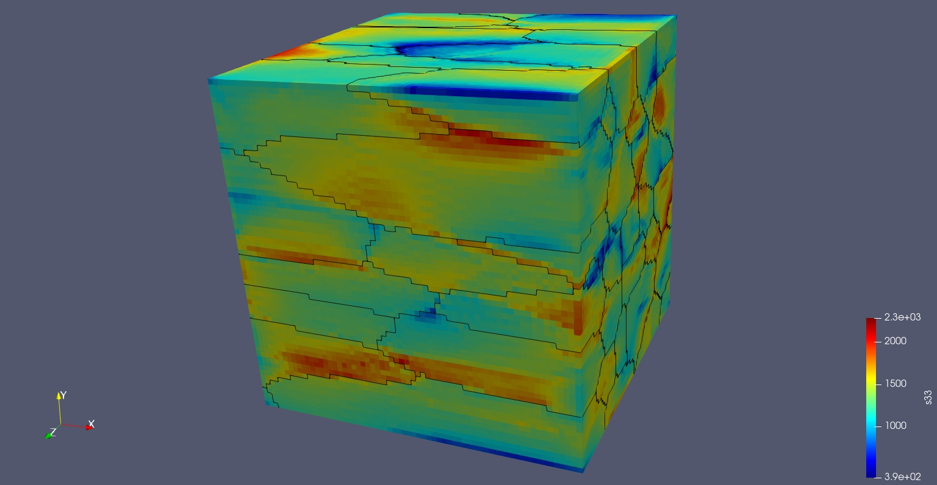
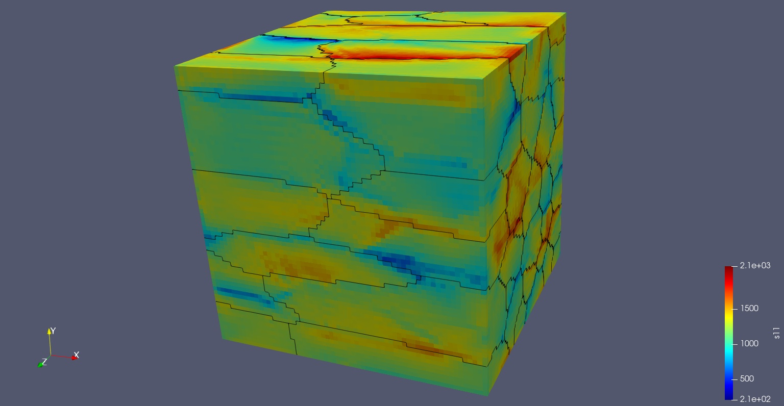
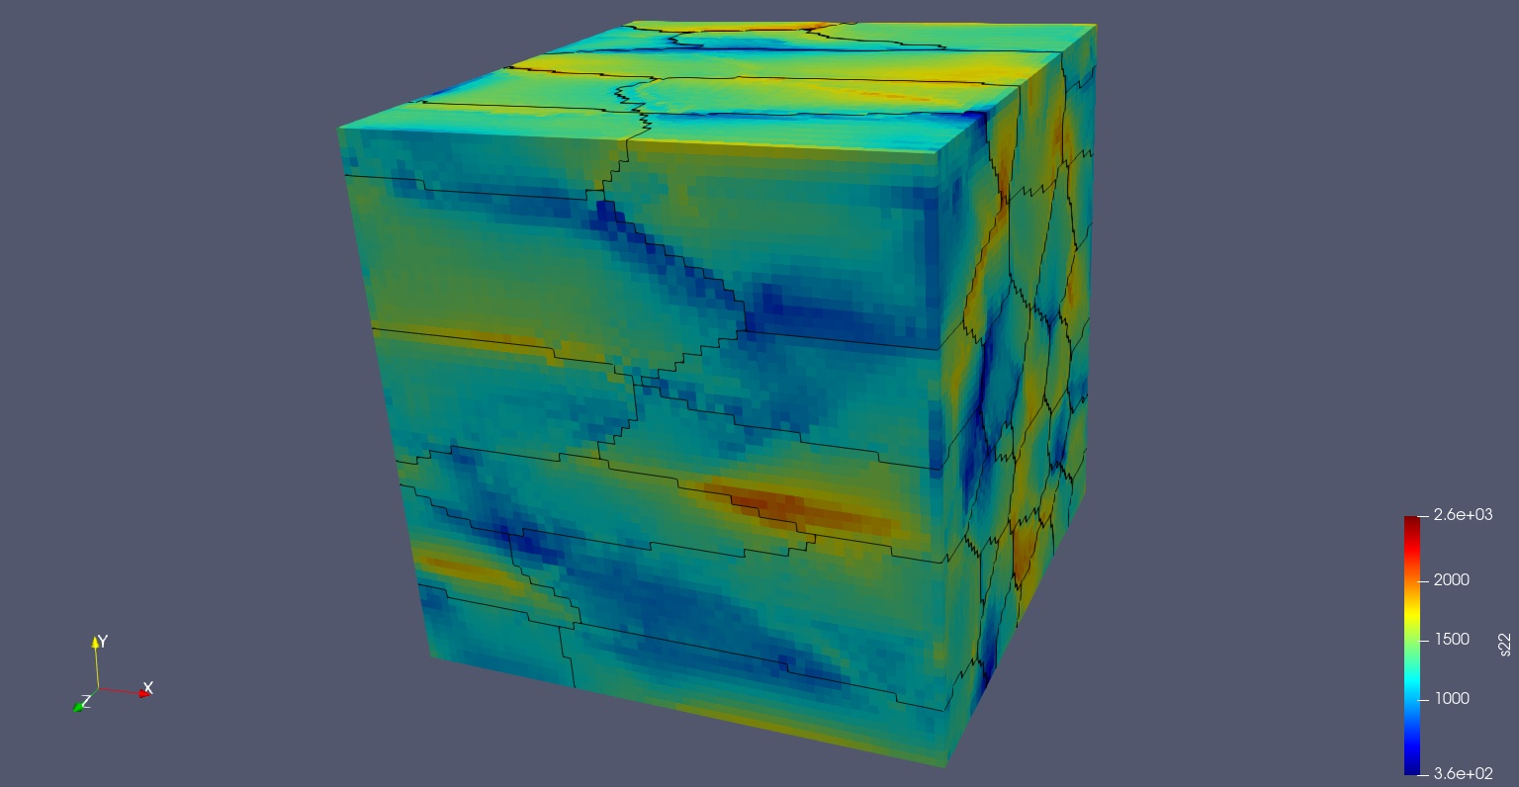
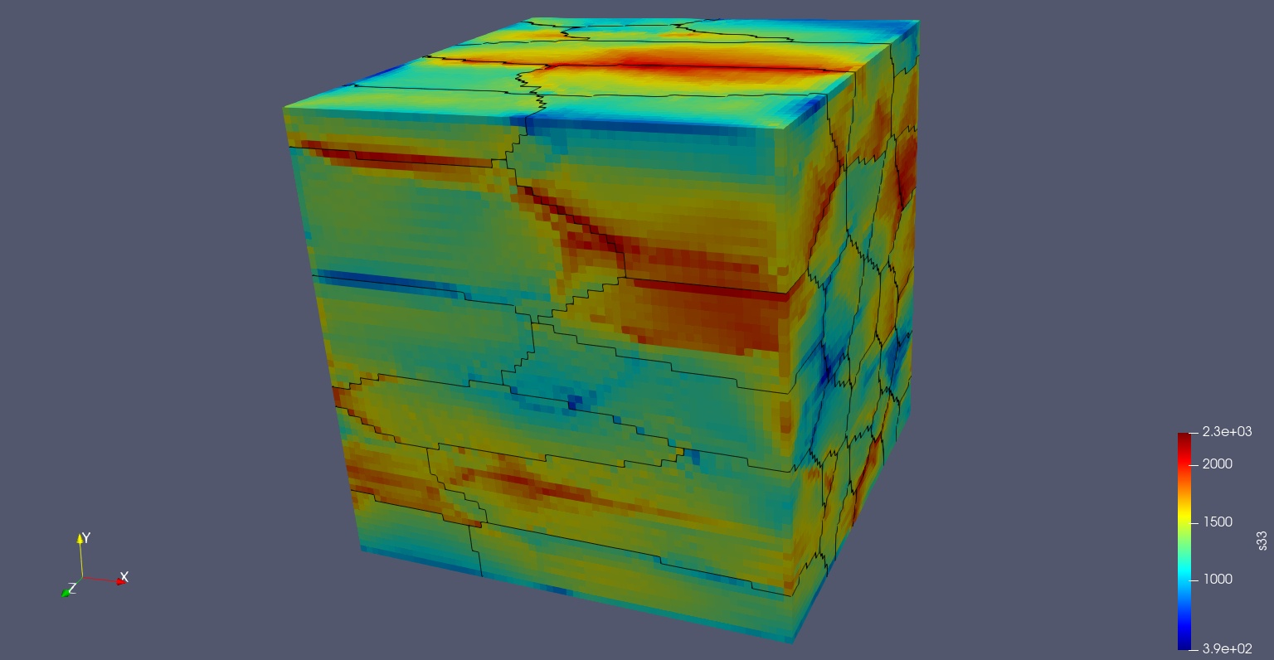
Example: Inconel 718 [EVPFFT on SSEs – S11, S22, S33]
X Load
Y Load
Z Load
SSE 1
SSE 2
SSE 3

Slide 11
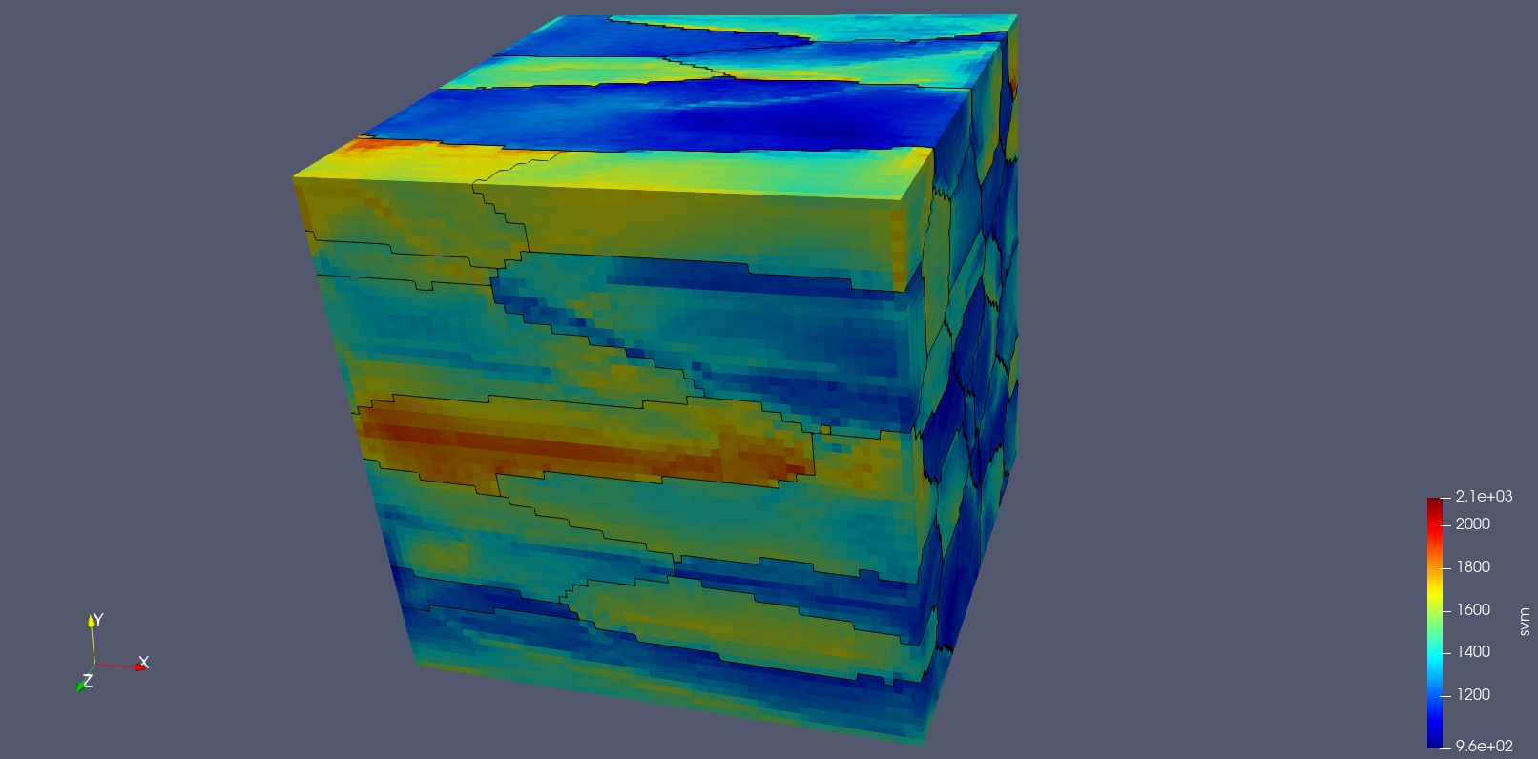
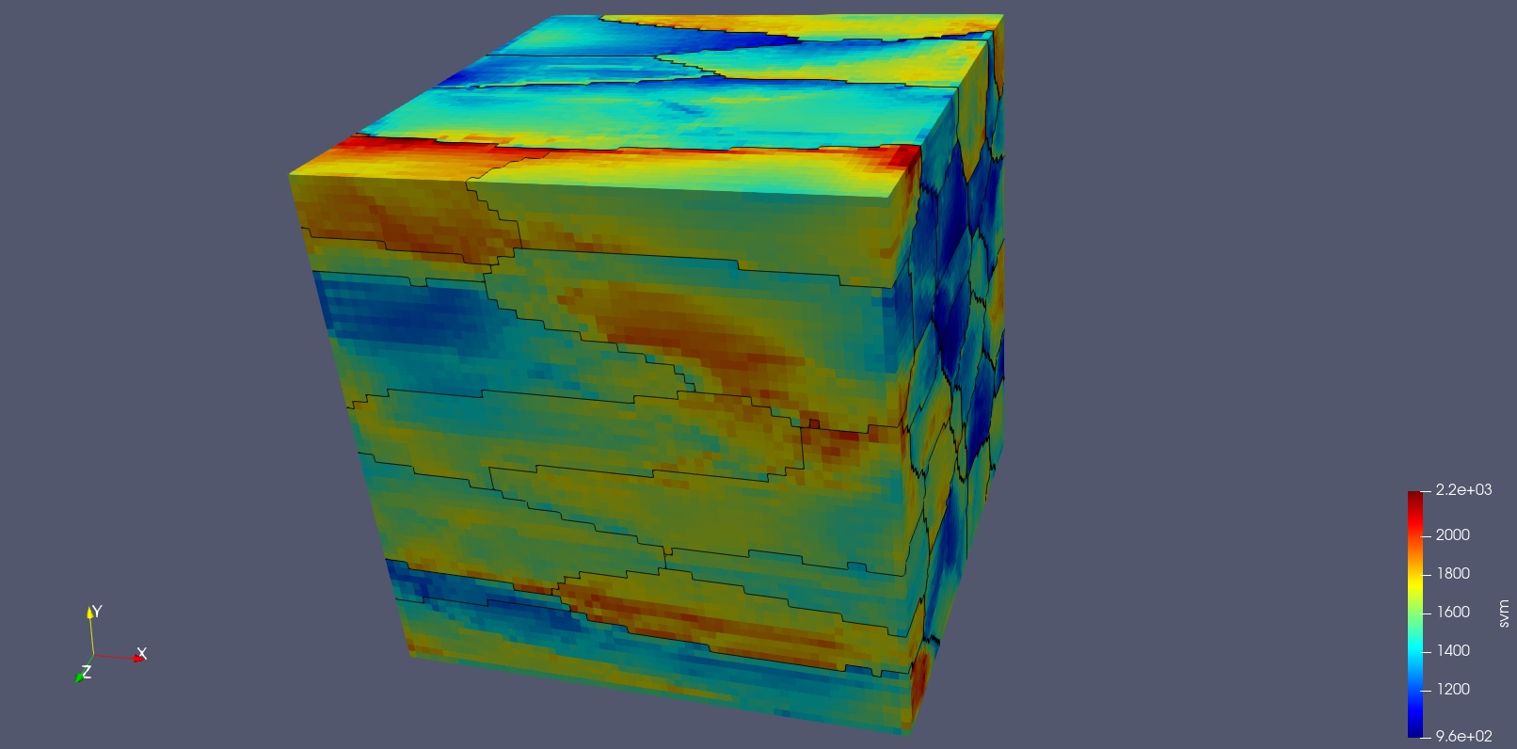
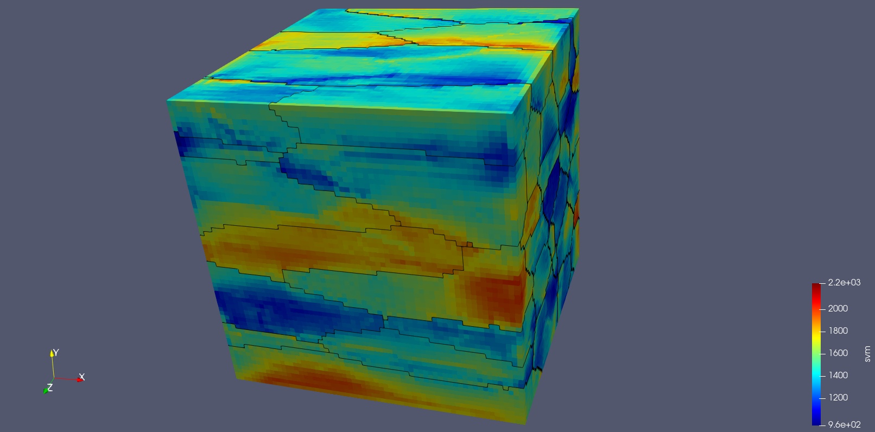
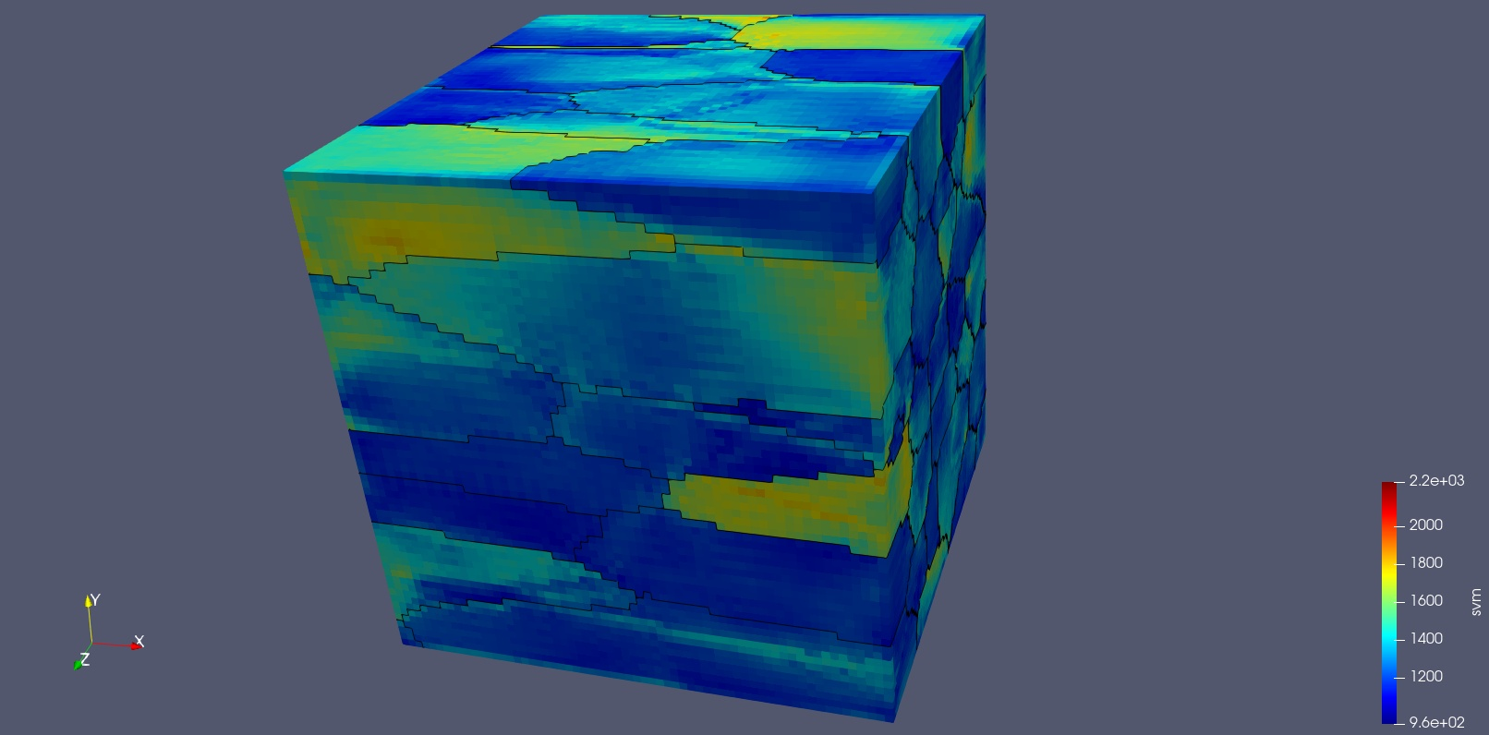
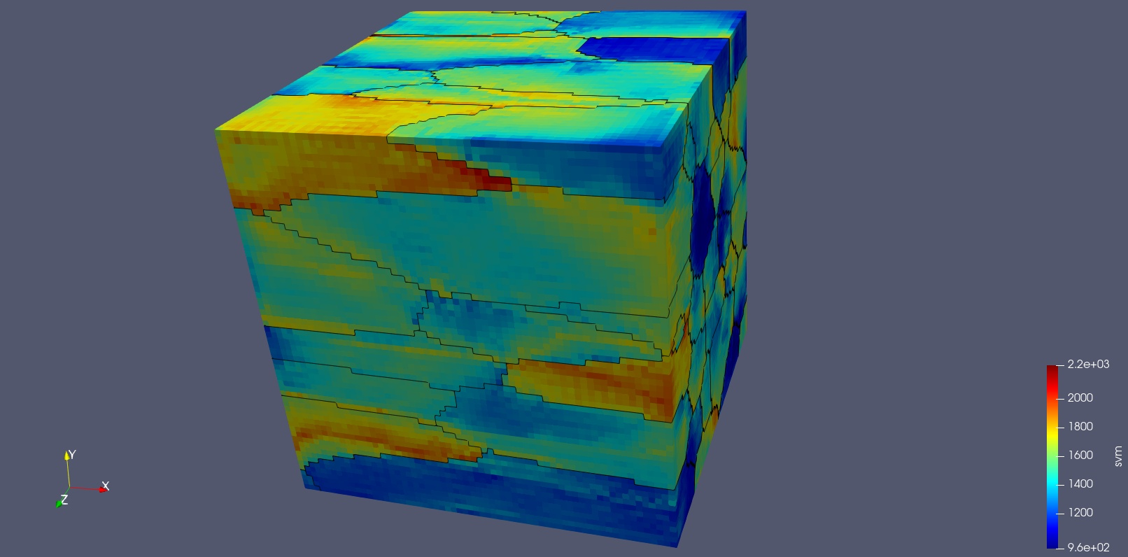
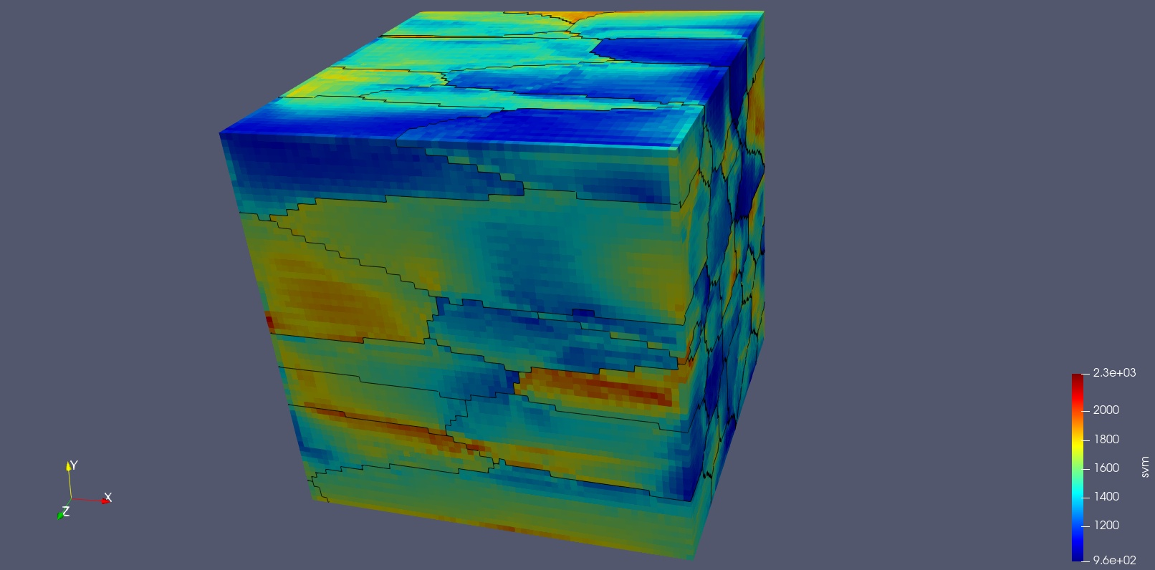
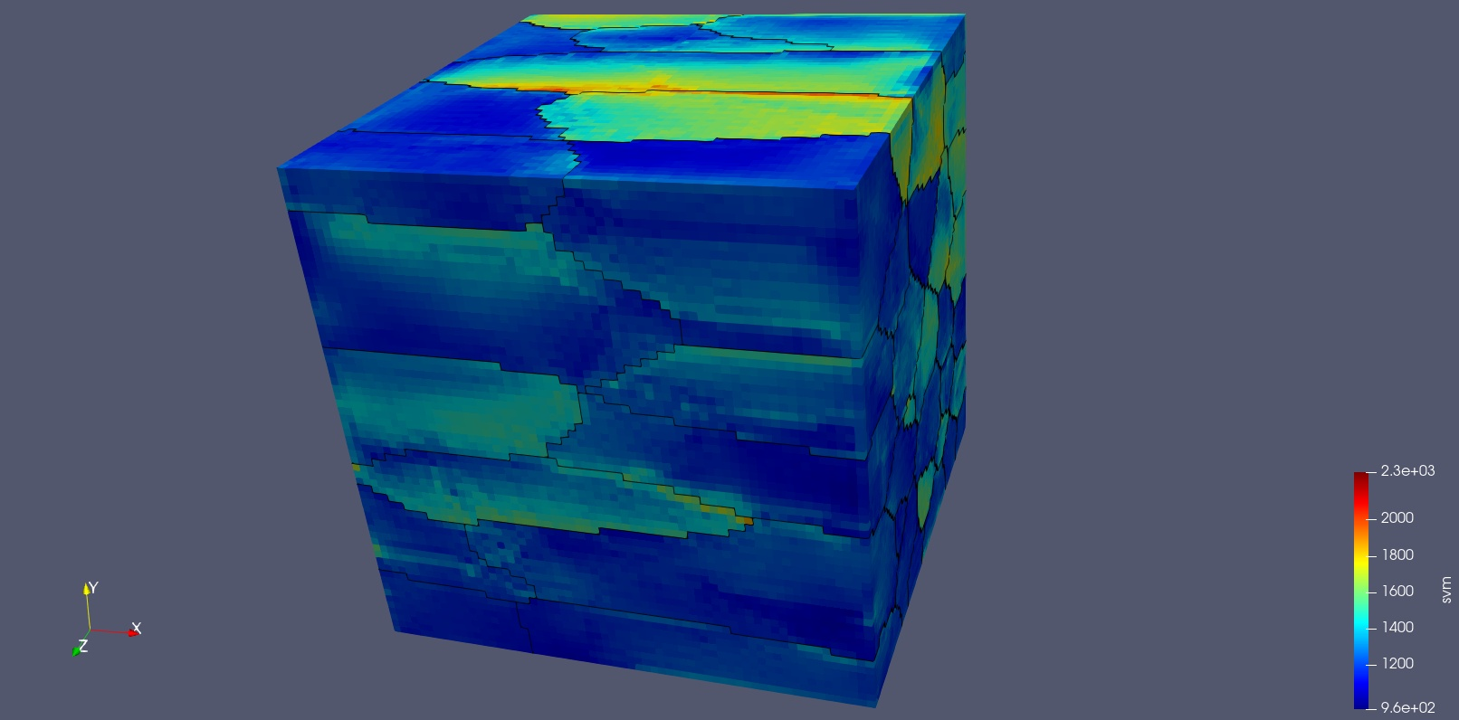
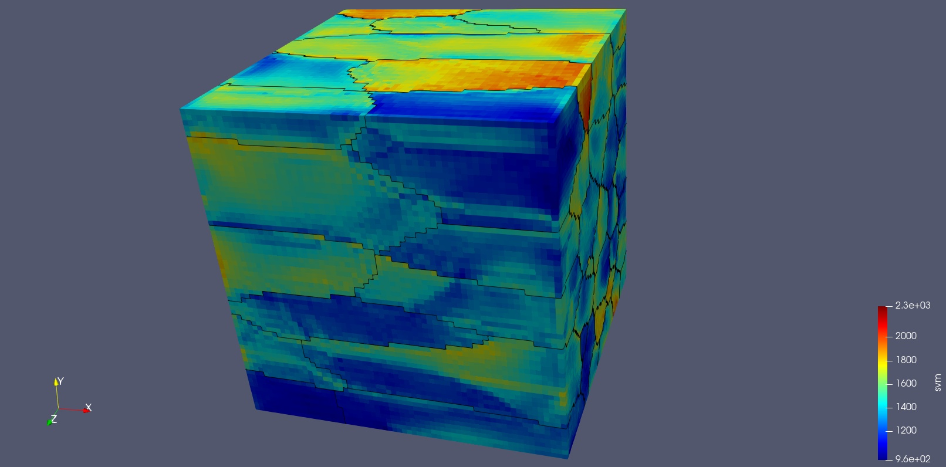
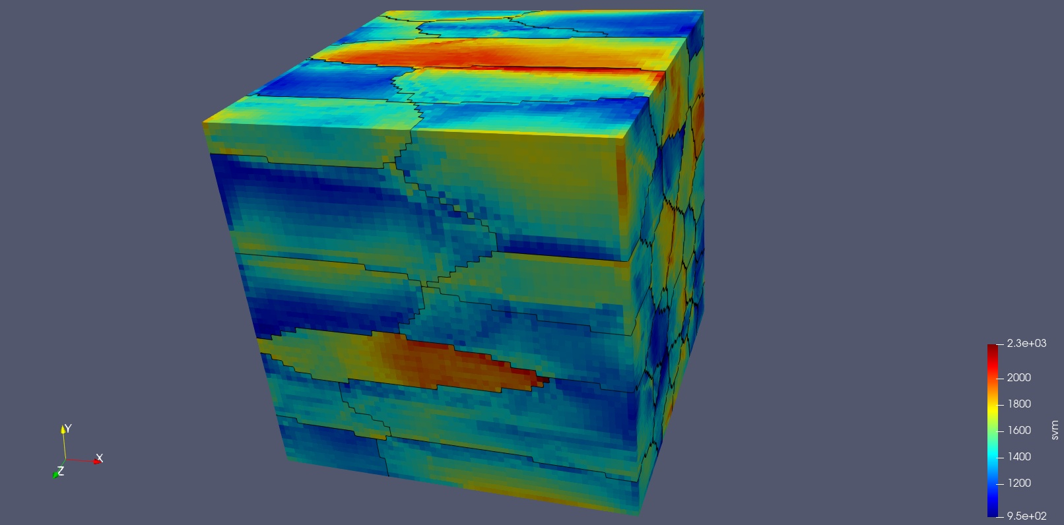
Example: Inconel 718 [EVPFFT on SSEs – Von Mises]
X Load - VM
Y Load - VM
Z Load – VM
SSE 1
SSE 2
SSE 3

Slide 12
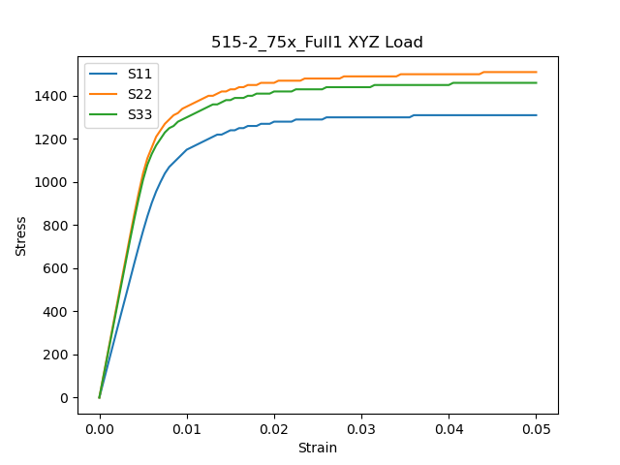

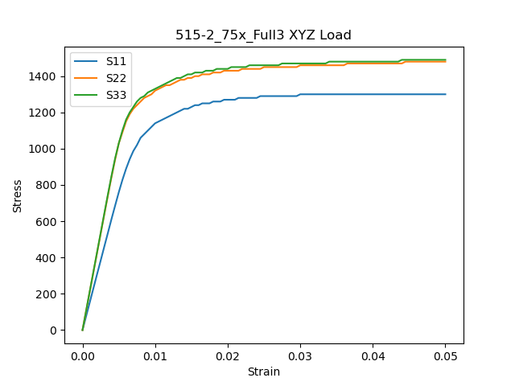
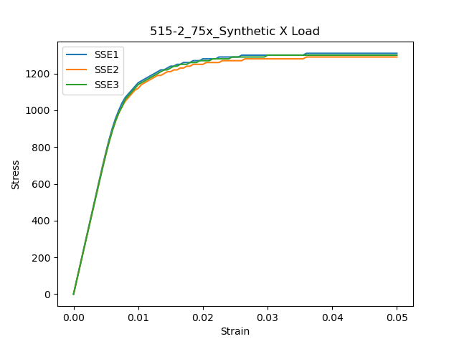
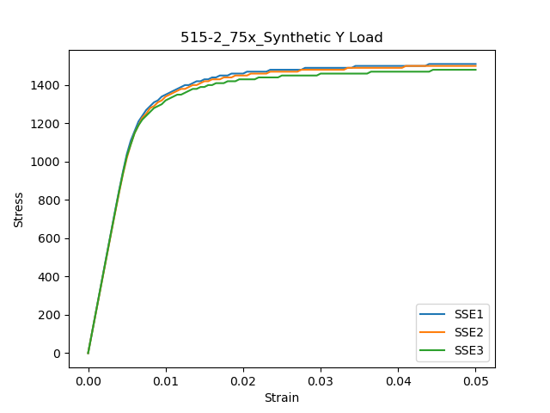
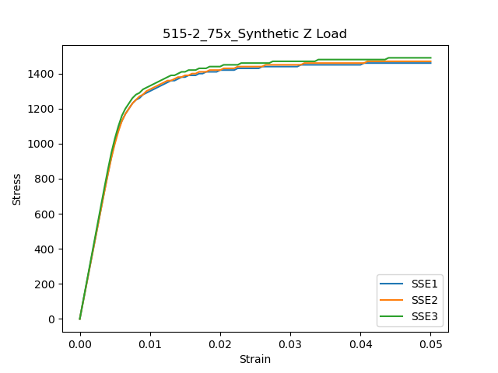
Example: Inconel 718 [EVPFFT on SSEs]
Str_str
Per SSE
Str_str
XYZ Load
Comparison

Slide 13
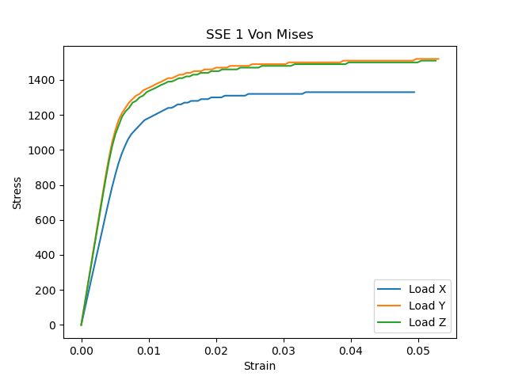
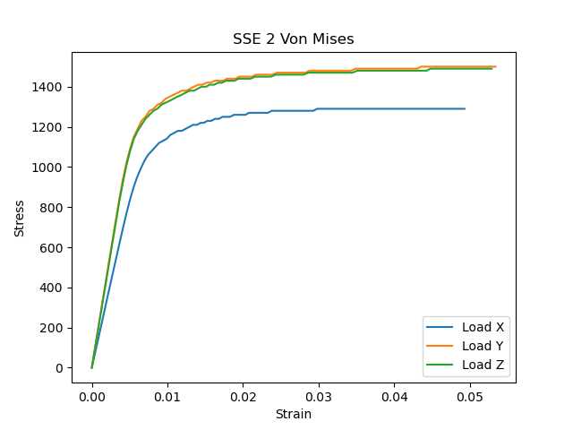
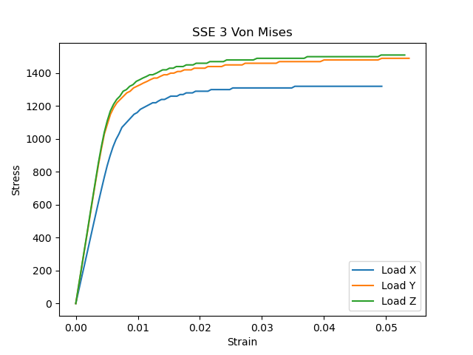
Example: Inconel 718 [EVPFFT – Von Mises]

